Slide 1
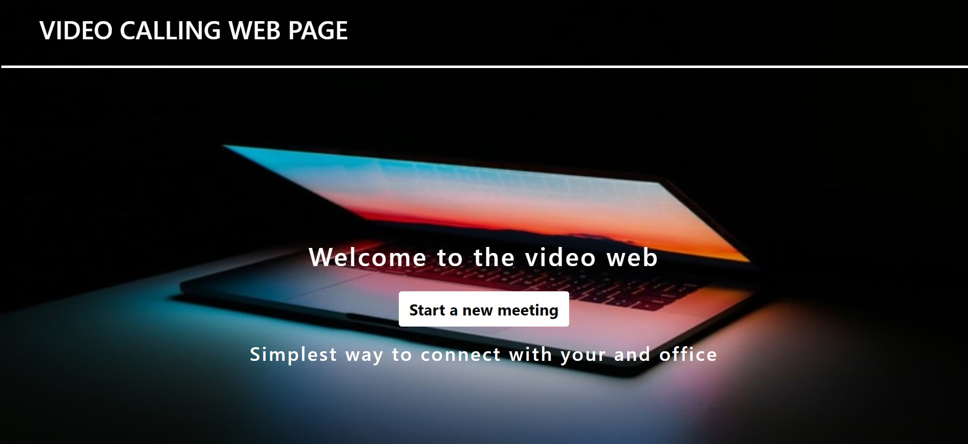
Video Meeting Web App

Slide 2
Introduction
Video calling is an online technology that allows users in different locations to hold face-to-face meetings without having to move to a single location together. This technology is particularly convenient for business users in different cities or even different countries because it saves time, expenses, and hassles associated with business travel. Uses for video calling include holding routine meetings, negotiating business deals, and interviewing job candidates.
Video calling platforms such as Zoom, Skype, and Microsoft Teams saw a surge of interest and use during the 2020-21 COVID-19 pandemic, as lockdowns forced many individuals around the world to work from home and attend online classes.
Our project is based on the video calling web page in which user connect with his family members, friends and business workers through this video calling Web.
We made this web app short and simple for user which help user easily calling through web.

Slide 3
Existing Method
1. Html and CSS
2. Chrome
3. Jitsi Container

Slide 4
Proposed Method with Architecture
1. Start
2. User visits a video calling web page
3. User click on the button “Start a new meeting”
4. User need to allow the mic and camera access
5. User need to type their name
6. After that click on join meeting
7. User can invite peoples by generating invitation link
8. In the meet user can chat, wave, share his/her screen with participants.

Slide 5
Methodology
1. Project summery
This project helps user to connect with their favourites through internet. User need to connect with the internet in order to call their relatives or anywhere. We made this web page simple and creative for the easy interaction.
2. Requirements
computer with 2 gb RAM required.
Internet or LAN connections
Processor with speed of 500 MHz
3. Constraints and Limitations
The system must be connected with internet. User need to install this application in their devices. As we have used jitsi private domain so may be advertisement running in the webpage.

Slide 6
Software Requirements
Operating System – Windows 10
Computer Processor- Intel cpu 2.80 GHz
Google Chrome

Slide 7
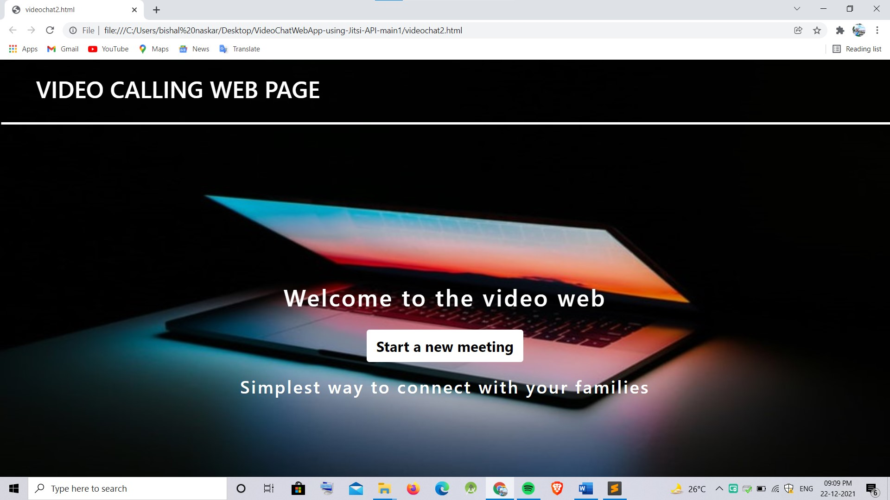
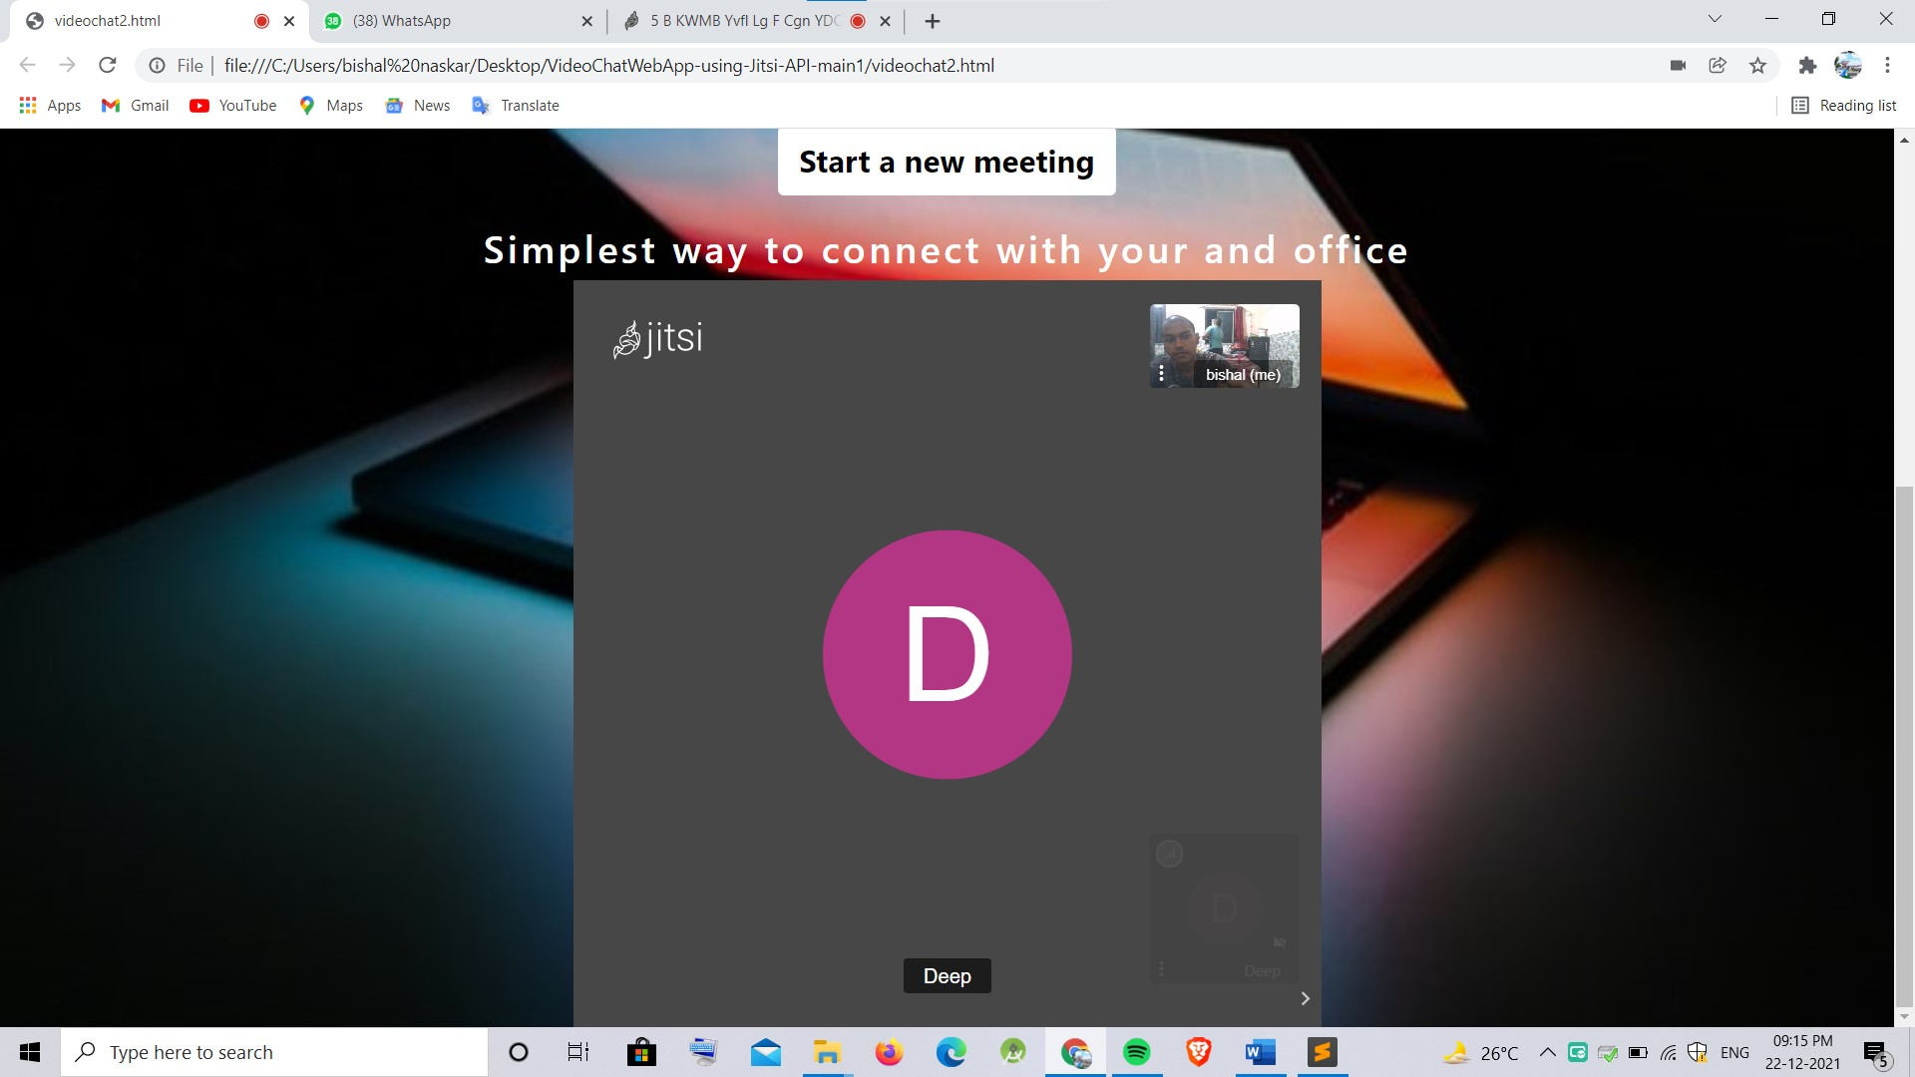
Output

Slide 8
Conclusion
From this project one can observe that how video calling applications or web works actually, how we connect our self in the internet.
It is a fast way to interacts with different types of user, we will get to know many things about them.
From this project we learned lot of about html and css language, how to work on html, how it works and many things.
Hope this project will give us confidence in future.

Slide 9
Reference
www.zoom.com
www.googlemeet.com
www.jitsicontainer.com

Slide 10
Thank You

